Slide 1

Price Hike Control

Slide 2
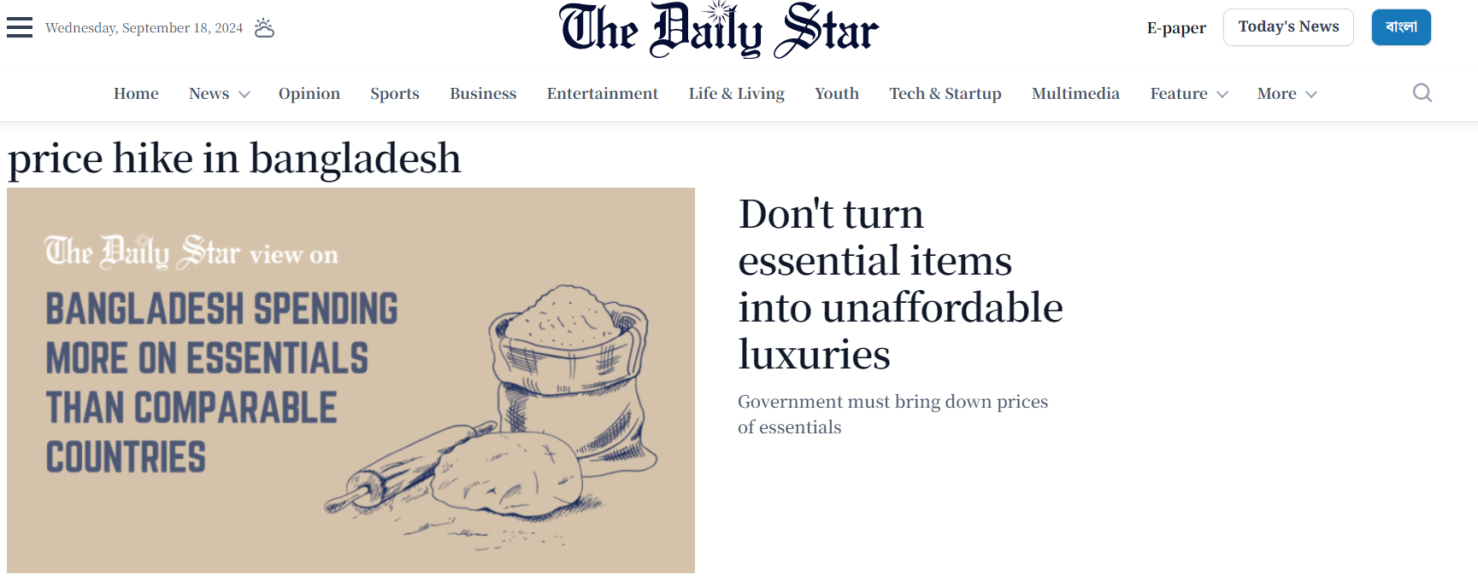

Slide 3


Slide 4
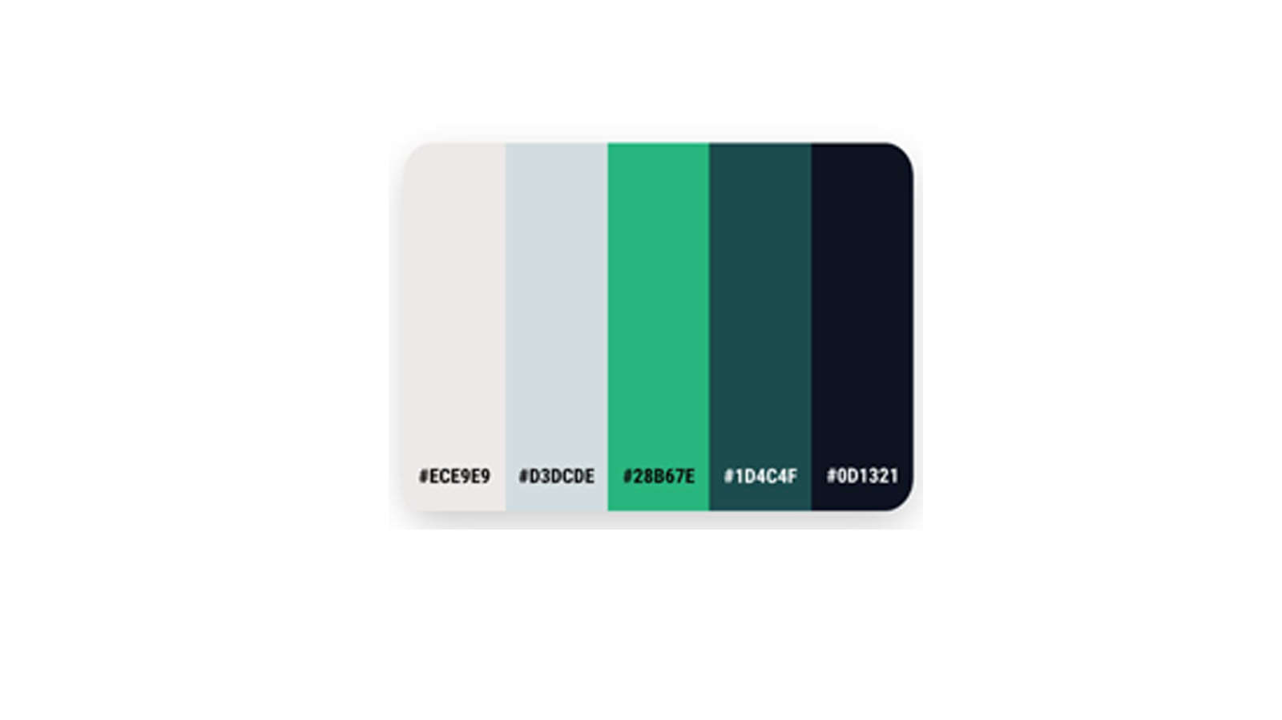
Color Palette:
Due to Government Projects color palette chosen as Green Shade.

Slide 5
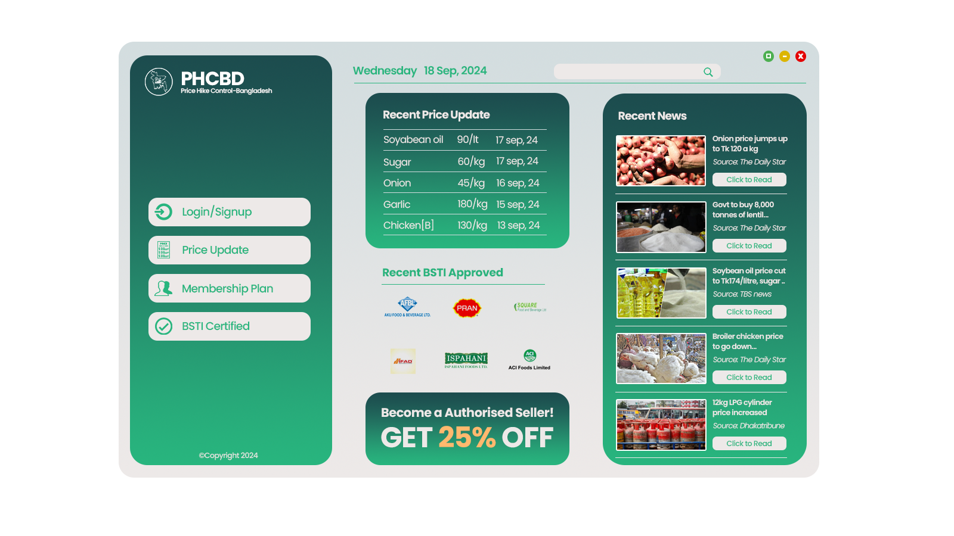

Slide 6
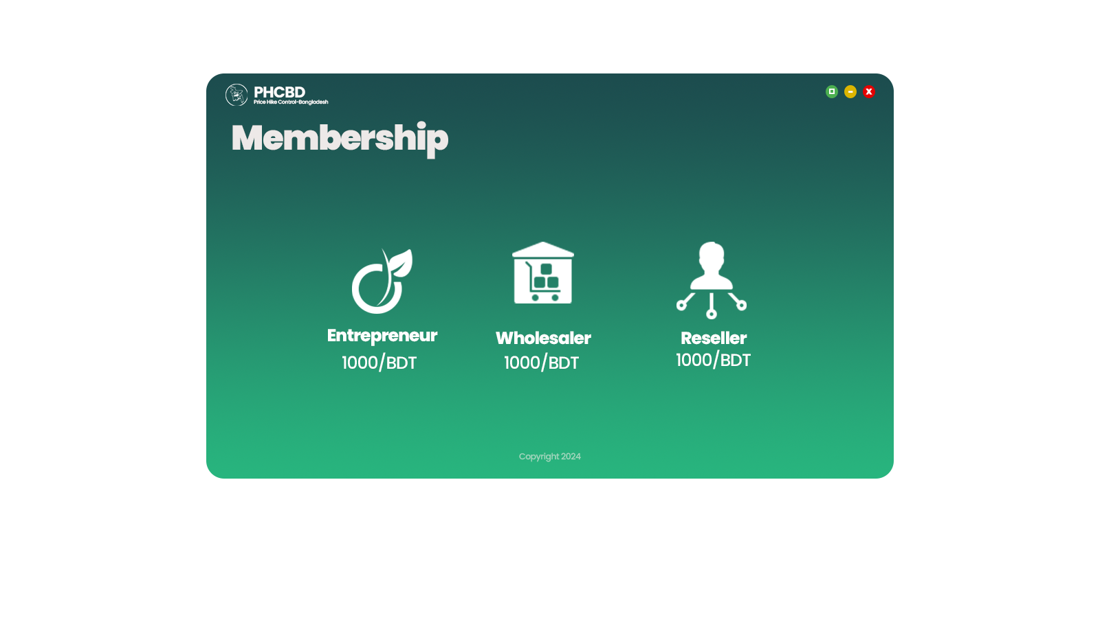

Slide 7
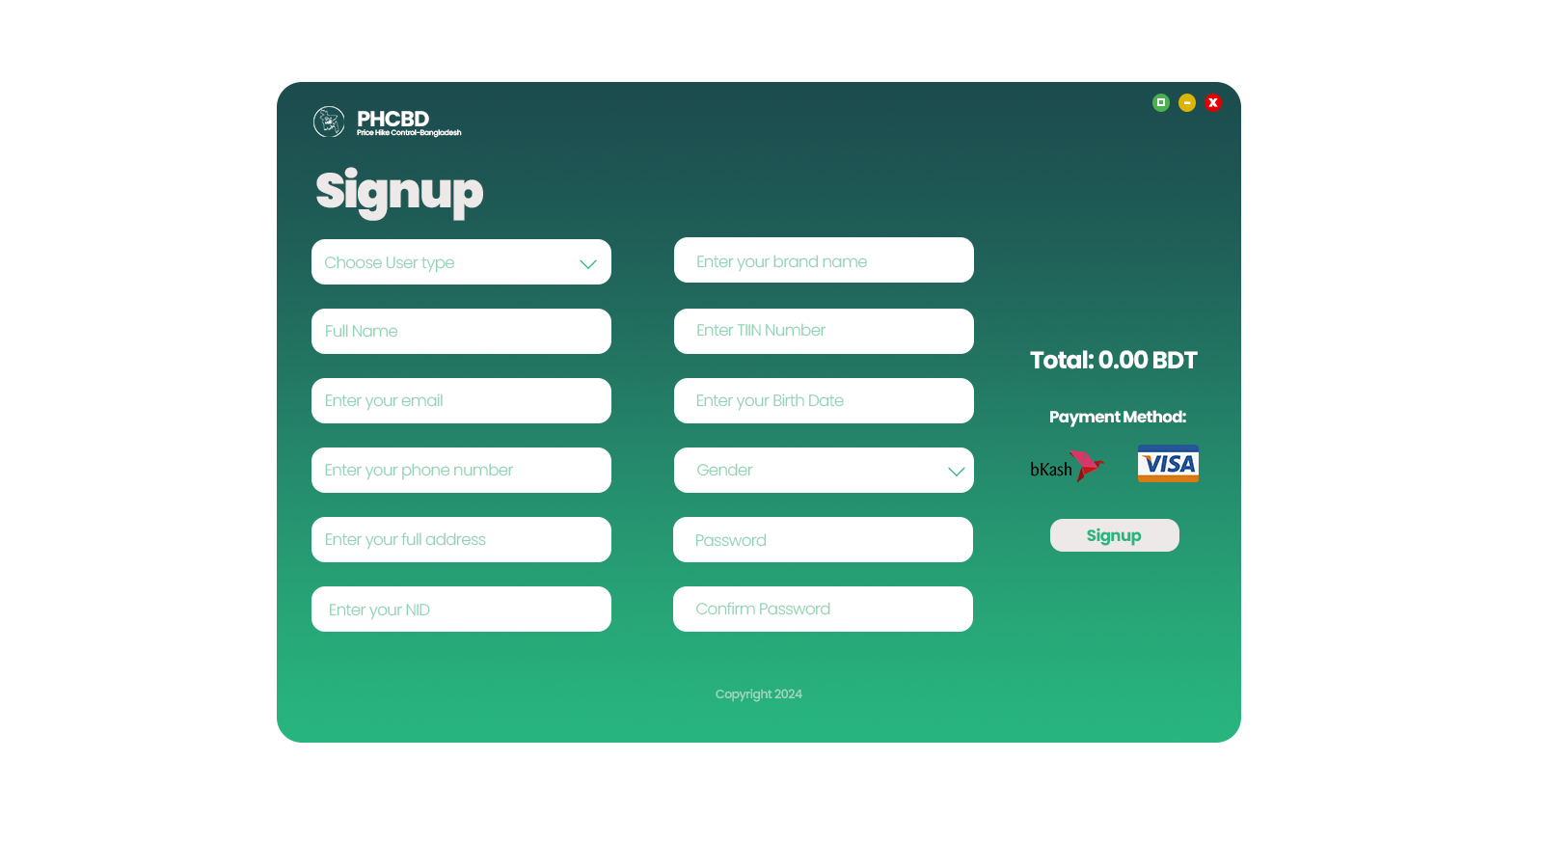
Reseller
Wholesaler
Entrepreneur

Slide 8
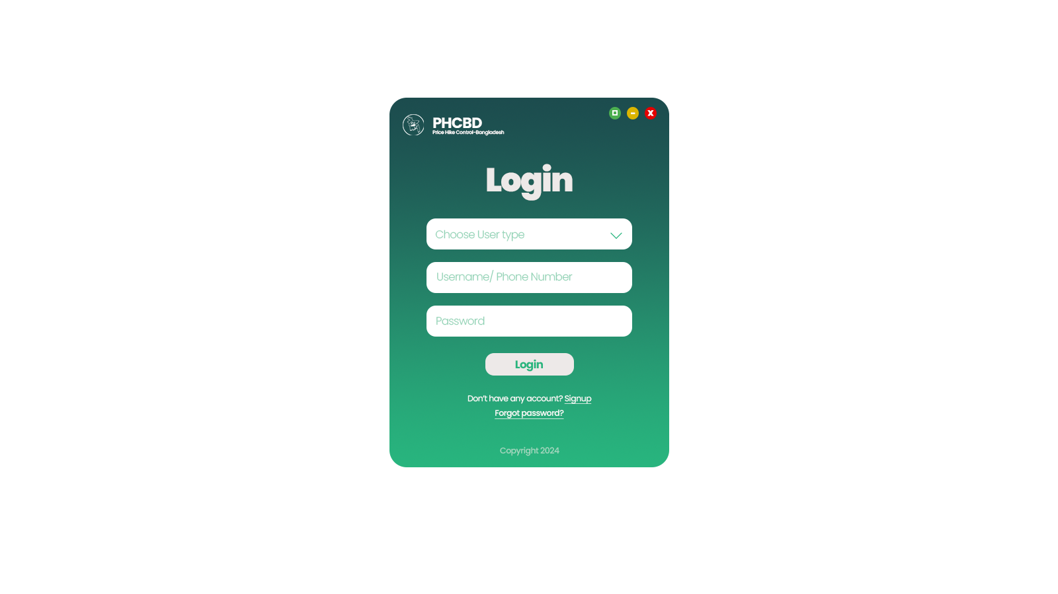
Reseller
Wholesaler
Entrepreneur

Slide 9
Individual Dashboard
For Each Login
-Under Development-

Slide 11
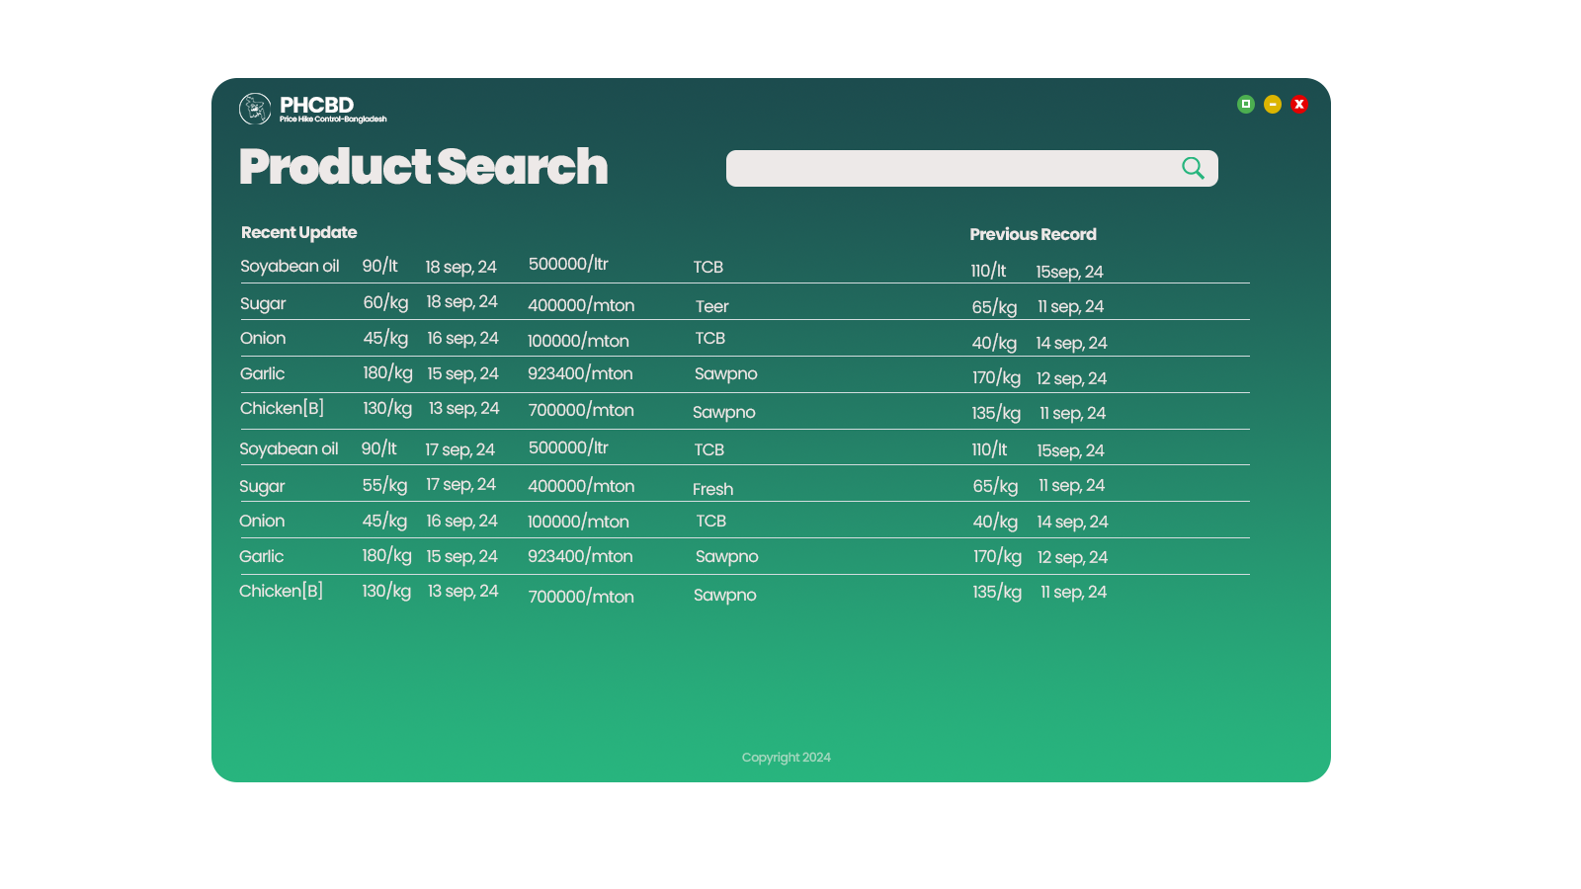

Slide 12
Things to concern:
Regular Monitoring
Physical Stock monitoring
Reach out to mass people or Rural area
Mobile App or a Responsive app needed

Slide 13
?
Any Question?

Slide 14
Thanks.

